Slide 1

Functional Distributed Programming Greg Thain

Slide 2

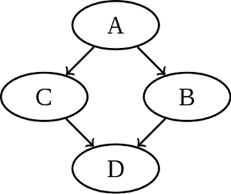










Output = F(input)
Your System Here
DAGMan

Slide 3

John Backus

Slide 4
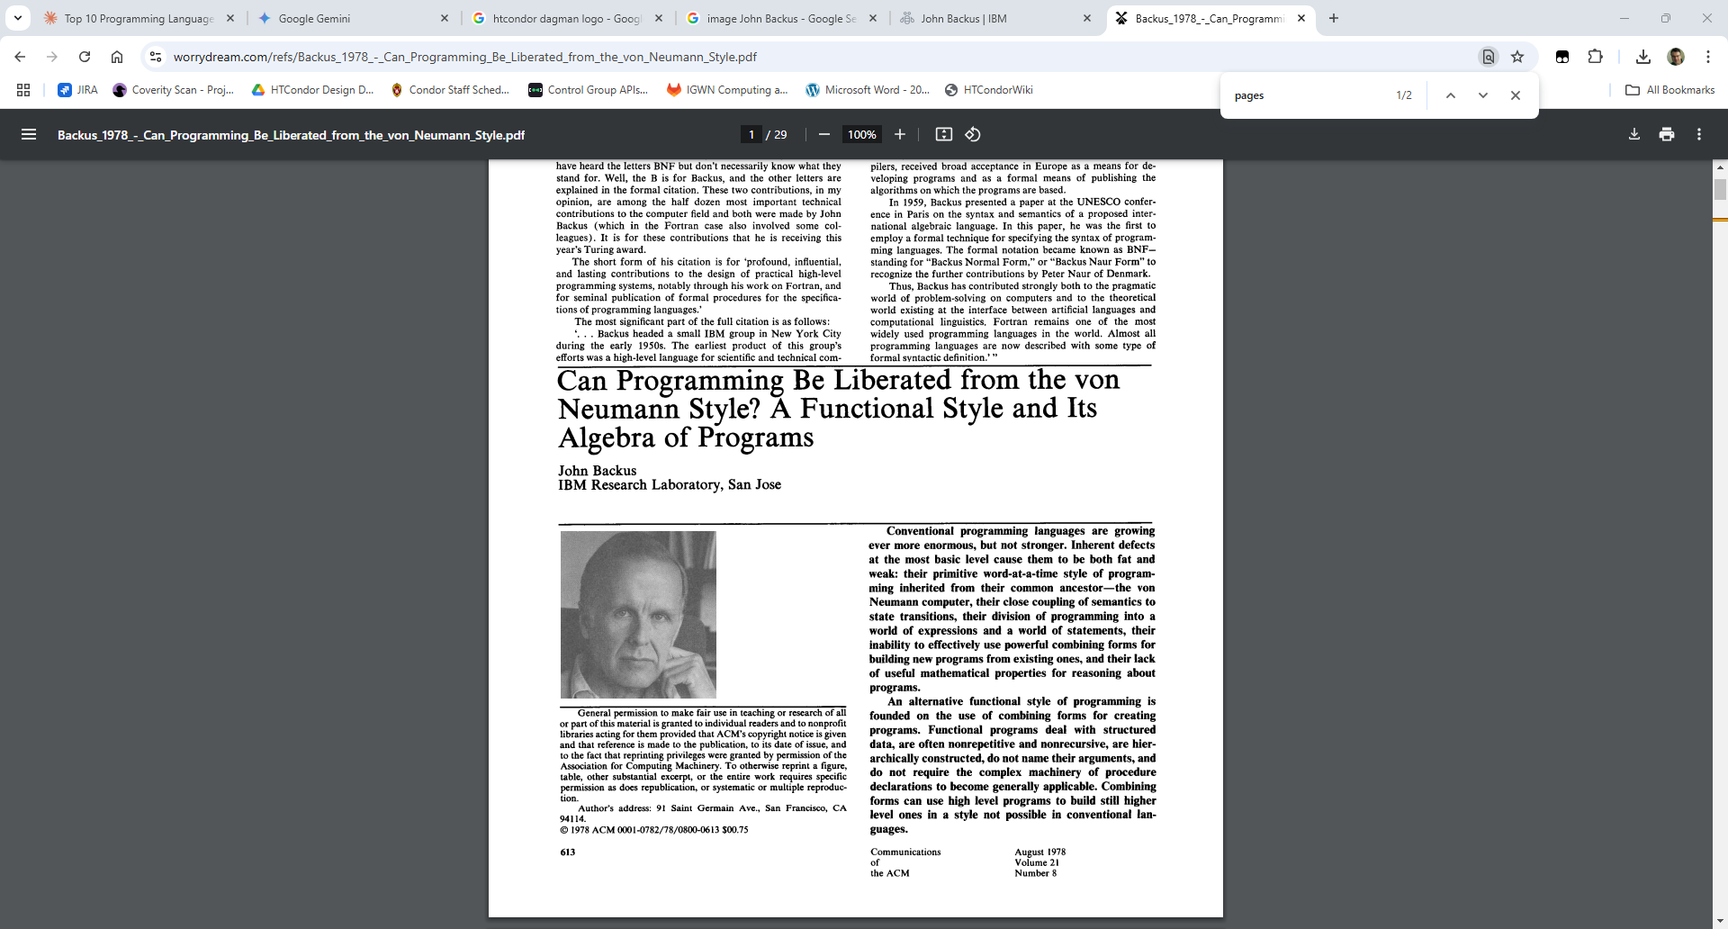



Slide 5
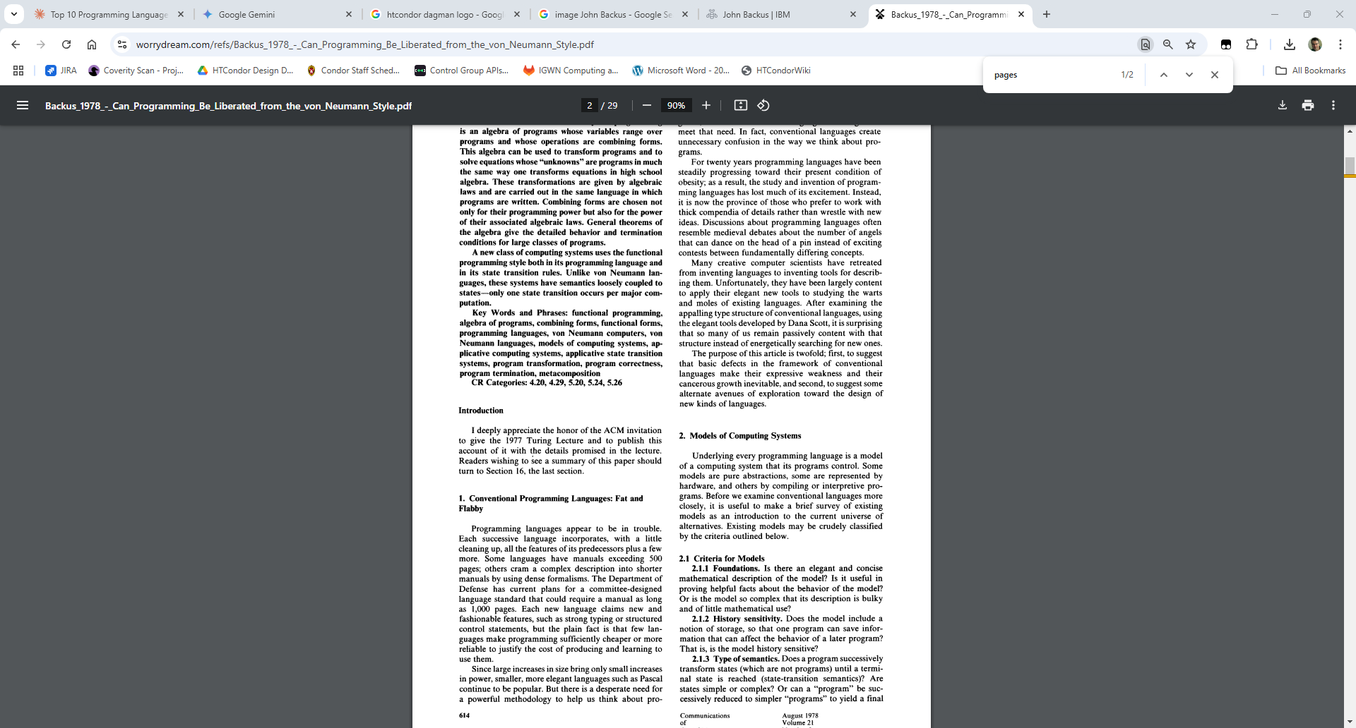
"Some languages have manuals exceeding 500 pages … few languages make programming sufficiently cheaper to justify the cost of producing .. them"

Slide 6
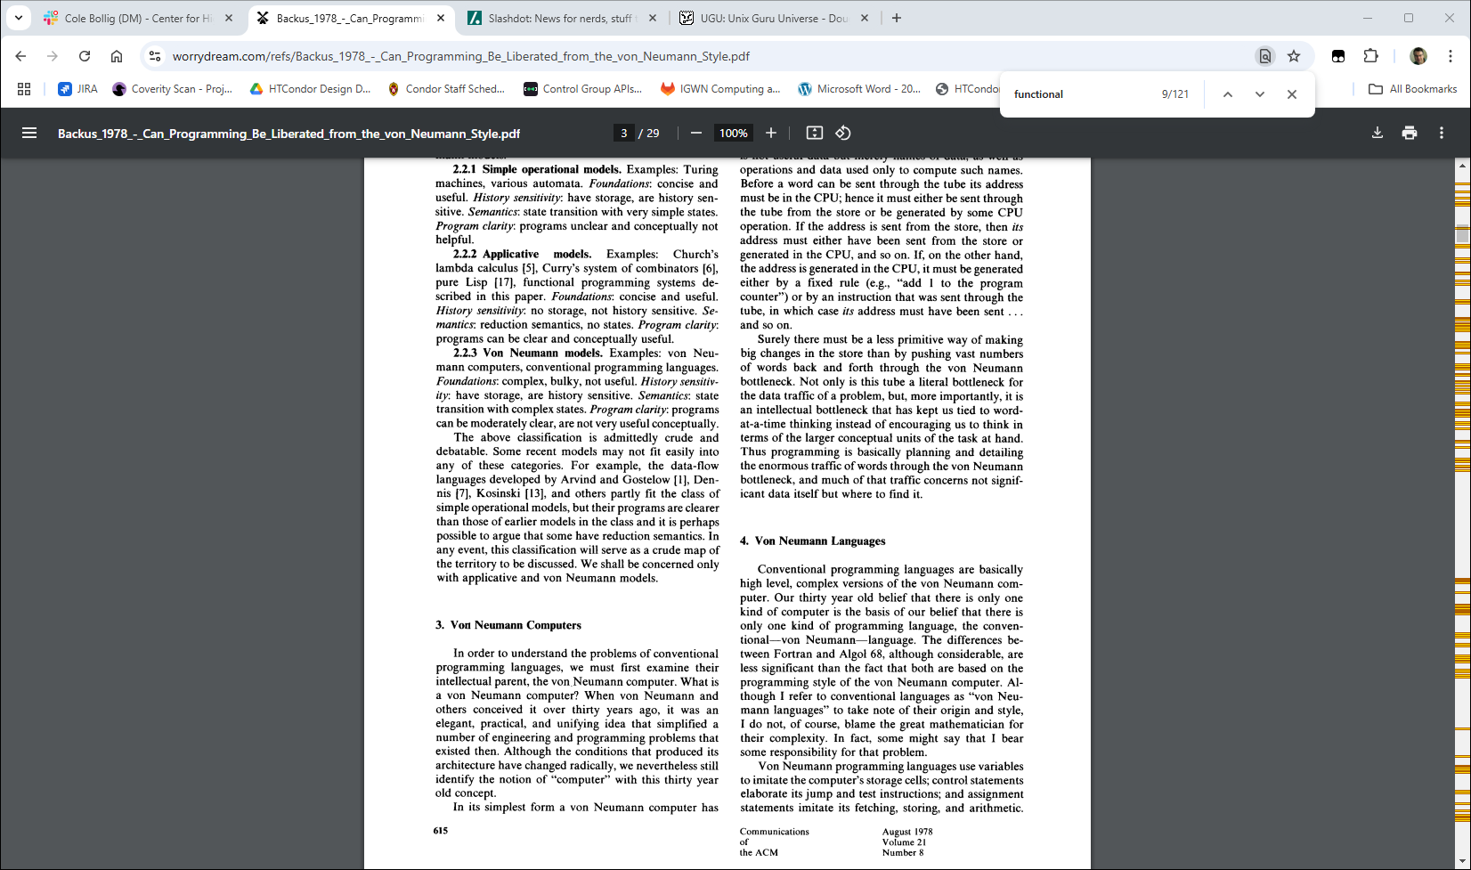
Von Neumann [traditional] programming languages use variables … control statements … and assignments.

Slide 7
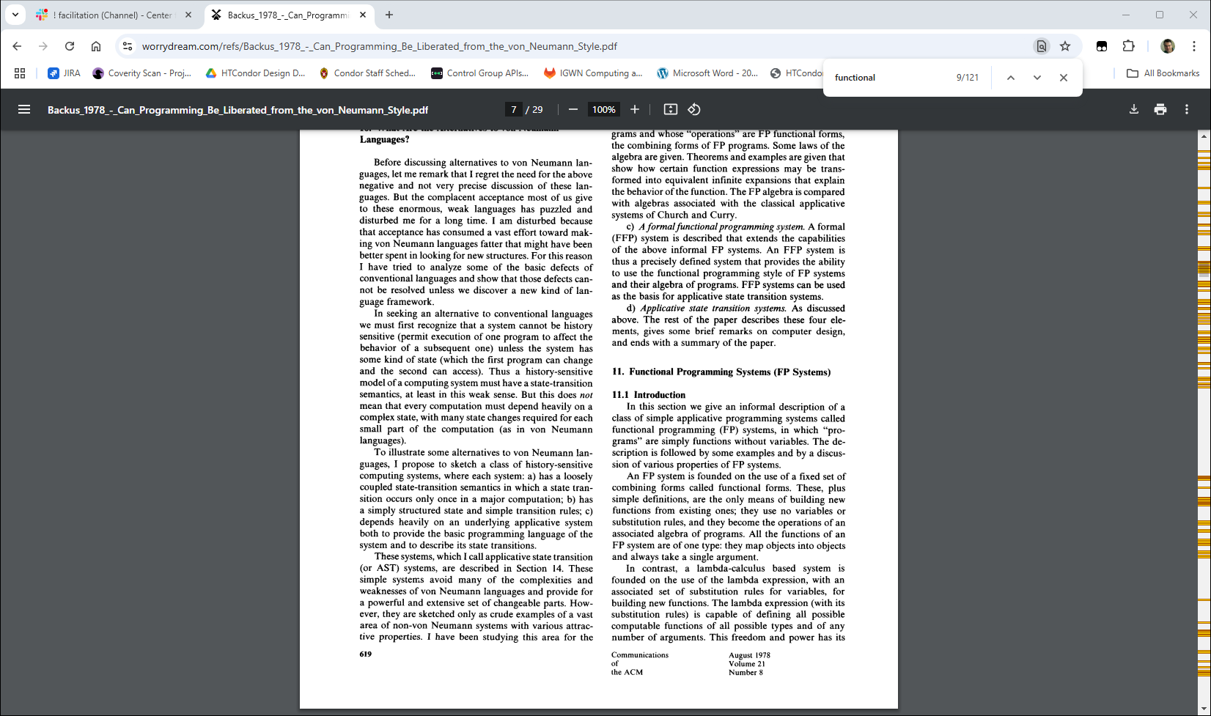
[In FP] programs are simply functions without variables… [and statements]
[With first class functions].. with a fixed set of combining forms

Slide 8
What IS a functional language?
Every function produces outputs that depend only on inputs
Every function is idempotent
Variables that are initialized once
No statements, only expressions

Slide 9
What IS NOT a functional program?
Global variables
Assignment
Mutable state
Explicit control flow statements

Slide 10
Example TRADITIONAL style
def inner_sum(a, b):
for i in range(len(a)):
c = c + (a[i] * b[i])
return c;

Slide 11
Example TRADITIONAL style
def inner_sum(a, b):
for i in range(len(a)):
c = c + (a[i] * b[i])
return c;
Example FUNCTIONAL style
def inner_sum(a, b):
return reduce(lambda acc, val: acc + val, map(lambda x, y: x * y, a, b), 0)

Slide 12

"A monad is a monoid in the category of endofunctions"
"Why is no one using our beautiful function languages?"

Slide 13

Jon Bentley's spell checker program challenge

Slide 14

Doug McIlory
A new functional programming language

Slide 15
$ prepare filename |
translit A-Z a-z |
translit ^a-z \n |
sort |
unique |
common -2 dict

Slide 16
$ prepare filename |
tr A-Z a-z |
tr ^a-z \n |
sort |
unique |
common -2 dict

Slide 17
Shell pipelines are a pure functional language!
And with a user-friendly syntax
But the whole shell language is not functional
Don't let the perfect be the enemy of the good

Slide 18
$ sort input | uniq | sort -n

Slide 19
$ sort(-n(uniq(sort)))

Slide 20
$ sort input | uniq | sort -n

Slide 21
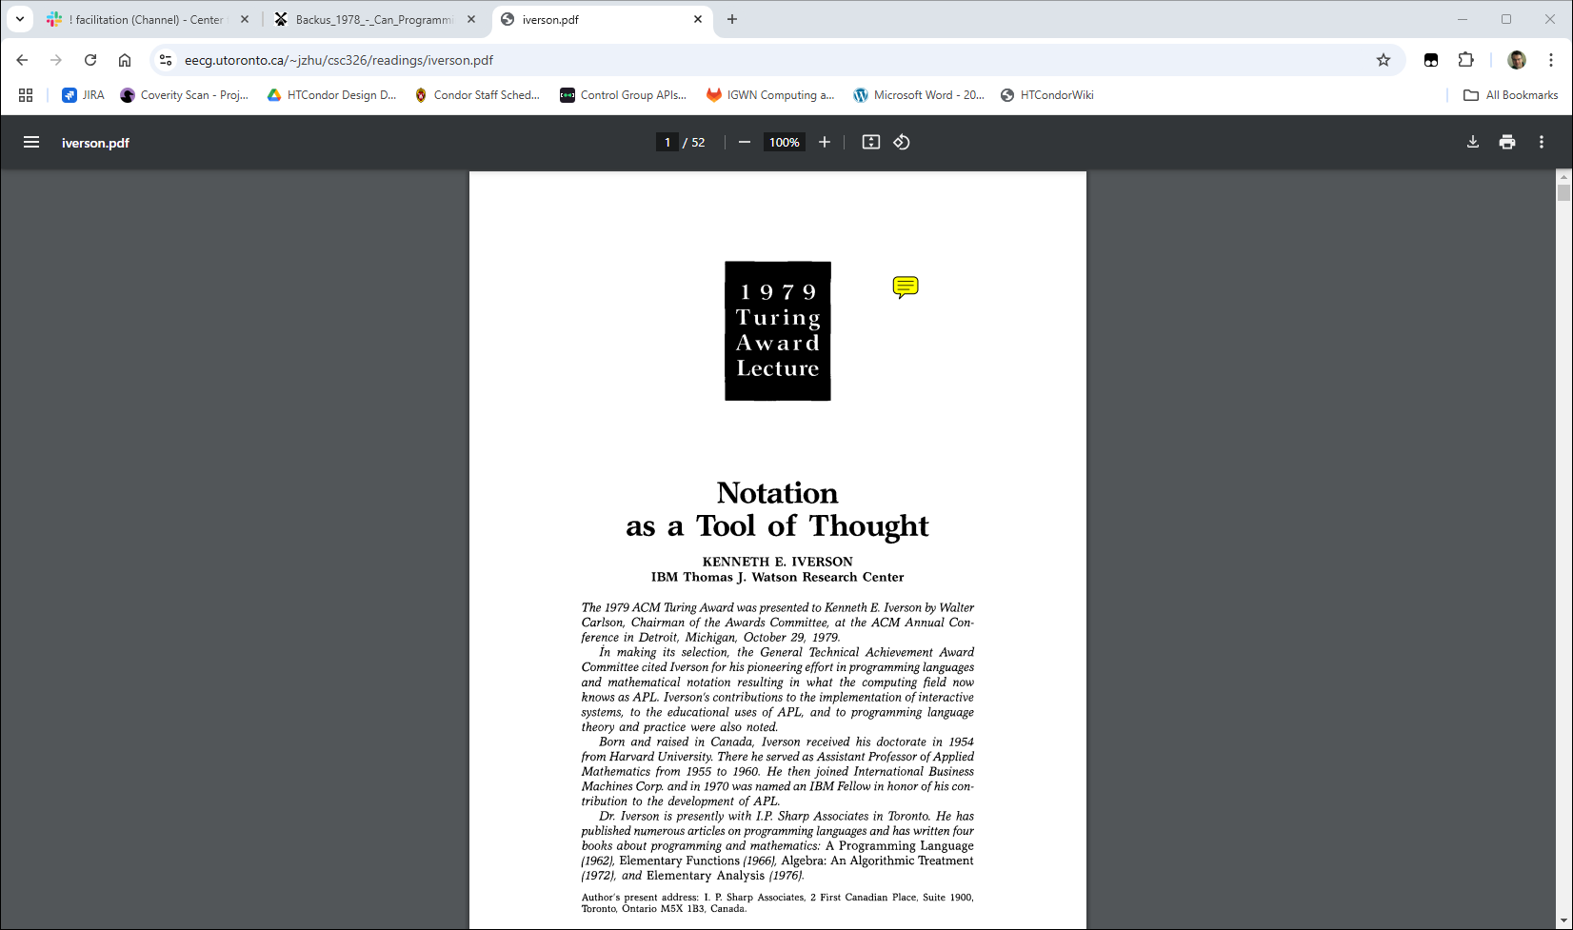

Slide 22
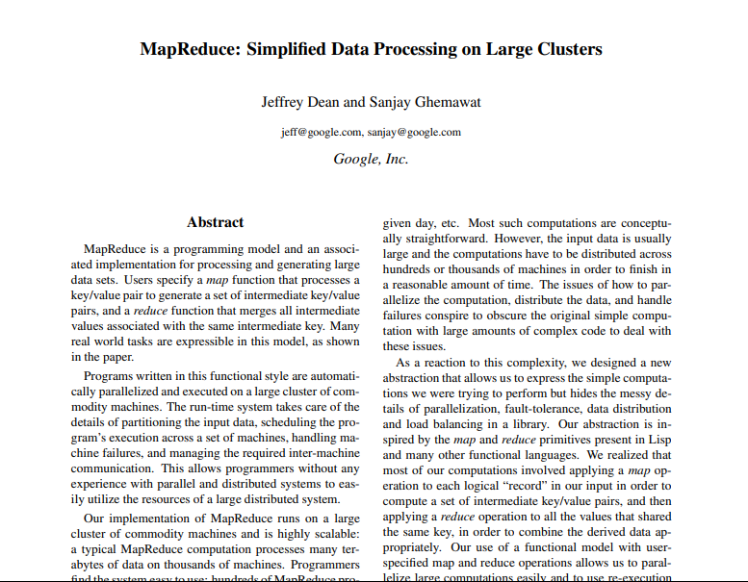

Slide 23
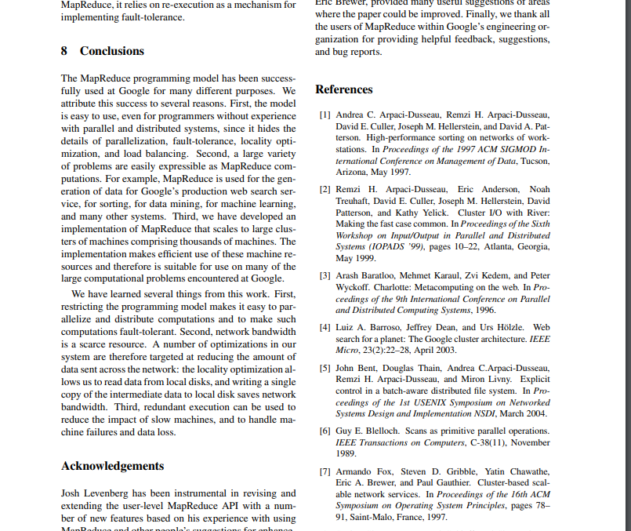
other friends
HTCondor Citation

Slide 24
def inner_sum(a, b):
return reduce(lambda acc, val: acc + val, map(lambda x, y: x * y, a, b), 0)
Loop "hidden" in reduce implies system manages jobs

Slide 25
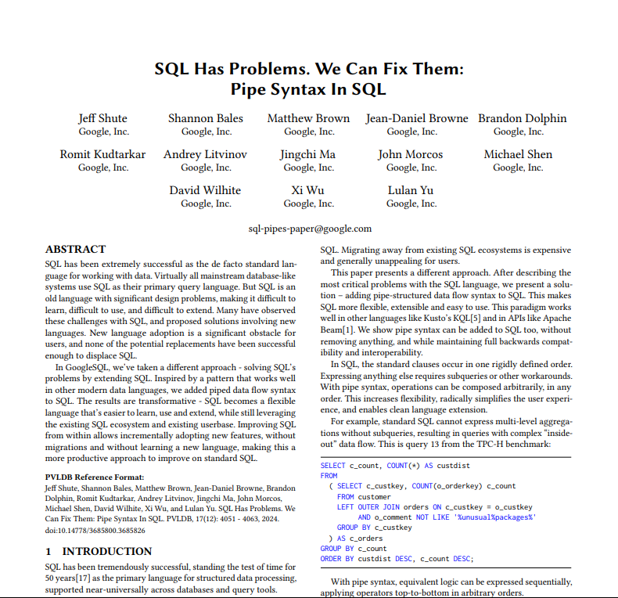

Slide 26
SELECT c_count, COUNT(*) AS custdist
FROM
( SELECT c_custkey, COUNT(o_orderkey) c_count
FROM customer
LEFT OUTER JOIN orders ON c_custkey = o_custkey
AND o_comment NOT LIKE '%unusual%packages%'
GROUP BY c_custkey
) AS c_orders
GROUP BY c_count
ORDER BY custdist DESC, c_count DESC;

Slide 27
FROM customer
|> LEFT OUTER JOIN orders ON c_custkey = o_custkey
AND o_comment NOT LIKE '%unusual%packages%'
|> AGGREGATE COUNT(o_orderkey) c_count
GROUP BY c_custkey
|> AGGREGATE COUNT(*) AS custdist
GROUP BY c_count
|> ORDER BY custdist DESC, c_count DESC;

Slide 28

Astronomers have pipelines, too

Slide 29
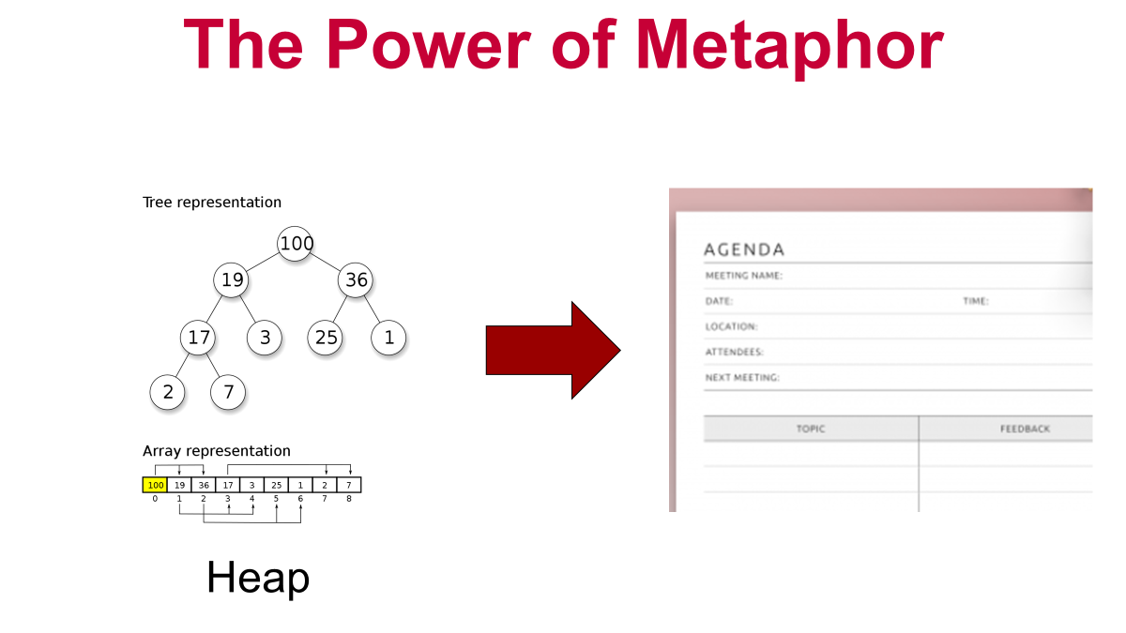
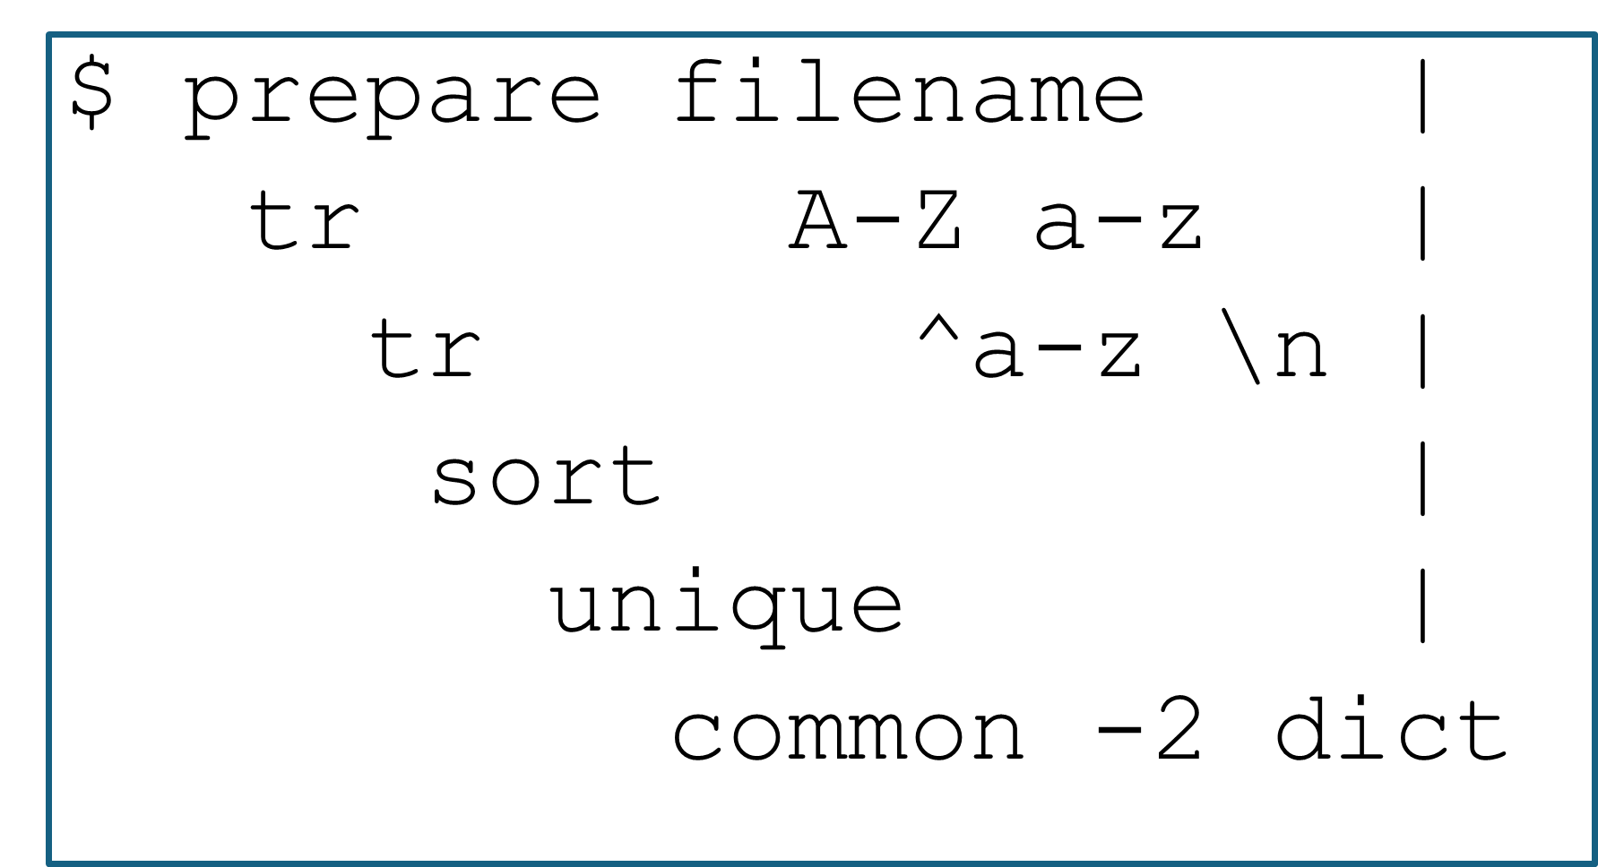

"Pipeline"

Slide 30

A Functional view of HTCondor jobs…

Slide 31
Functional explanations of common problems
Shared Filesystems
Random number seeding
Pelican output objects
… And generating their solutions!

Slide 32

Executable = calculate
Arguments = 1 2 3
transfer_input_files = my_input_files
Should_transfer_files = yes queue
Job
Execution Point
Access Point

Slide 33
Explicit Global state (shared fs)
Like a global variable Not explicit in job description
NOT PURE FUNCTIONAL !
Executable = calculate
Arguments = 1 2 3
queue
Job
NFS
Execution Point
Access Point

Slide 34
Lessons from shared fs example
Submit file description like functional arguments
Explicit is terrific
Shared file system like global state
Can fix it by explicitly describing inputs!
Executable = calculate
Arguments = 1 2 3
transfer_input_files = my_input_files
Should_transfer_files = yes queue

Slide 35
Random number seeding
rando_num = Random.get_next();

Slide 36
5
1
15
4
9
…
Seed 1
100
77
142
6
44
…
Seed 2
37
41
765
2
8
…
Seed 3
"Random" numbers one of infinite sequence, given a seed
So, how to pick seed? Often, the job picks the seed (based on time … ?)

Slide 37
Seed
Seed is like a shared file
Implicit global state?
NOT PURE FUNCTIONAL !
Executable = calculate
Arguments = 1 2 3
queue
Job
Execution Point
Access Point

Slide 38
Sidebar:
Perfectly functional random:
GetRandom(seed, sequence);
Executable = calculate
Arguments = 1 2 3
Input_files = seed
queue
Job
Seed
Execution Point
Access Point

Slide 39
Solution: Initialize, but never mutate Give new object new names
cache
Job
Job
Site A
Backing store
cache
origin
Job
Site B
cache
Site C

Slide 40
Conclusion…
Output = F(input)
Thinking in a functional way helps us solve real problems
Don't let the perfect be the enemy of the good
What about functional combinators for workflows?
What are other solutions that functional thinking solves?
This material is based upon work supported by the National Science Foundation under Grant Nos. 2030508. Any opinions, findings, and
conclusions or recommendations expressed in this material are those of the author(s) and do not necessarily reflect the views of the
National Science Foundation.

